Slide 1


GUN VIOLENCE
Brought to you by
Andrei Chaplygin
Edgar Sanchez
Craig Taylor
Kimmy Truong
Notes:
[Click] -> Title and ‘brought by’ appear [Click] -> Team members appear

Slide 2

San Bernardino,CA
ORLANDO,FL
Waco,TX
Roseburg,OR
LAS VEGAS,NV
Sutherland Springs, TX
Parkland,FL
Washington Navy Yard,DC
Notes:
[Cities appear] (Narrator) Do you know what these cities have in common? Right, these are the places where the deadliest mass shootings in modern US history happened. Each of them has left its mark on our society and stoke the fire of the never-ending discussion: do we need stricter gun laws? Do more guns prevent more crimes? Can you actually feel safe when a random bystander can carry a gun?
Most of these and similar questions may actually appeal to our emotions but in this project we’ll try to answer some of them using cold hard data

Slide 3
QUESTIONS
Correlation between gun violence and demography? (spoiler: maybe)
Correlation between gun violence and geography? (spoiler: maybe)
Correlation between gun violence and gun laws? (spoiler: maybe)
Correlation between gun violence and its types? (spoiler: indeed)
vs. DATA
Comprehensive data of over 260k US gun violence incidents for 2013-2018 https://www.kaggle.com/jameslko/gun-violence-data
A compilation of gun-related rules and laws per state https://www.gunstocarry.com/gun-laws-state/
A population data https://www.census.gov/data/developers/data-sets/popest-popproj/popest.html
Notes:
[Click] -> Questions appear -> [Narrator] Describe the questions, explain what exactly we mean by “demography” (age of subjects/victims), “geography” (cities and states/state population per capita), “gun laws” (the consolidate gun friendliness rating of each state) “violence types” (explain that there are ‘suicides’, ‘mass shootings’ and ‘self defence’)
[Click] -> Data appear -> [Narrator] Just some general comments on the data. Explain that Kaggle datasource actually comes from gunviolencearchive.org – non-profit corporation that tracks all reported cases that involve usage of guns

Slide 4
WHAT IS UNDER THE HOOD
The CSV file contains data for all recorded gun violence incidents in the US between January 2013 and March 2018 containing date, location, number of victims, gun types, participants and incident categories
…BUT IS IT CLEAN ENOUGH?
1 2 3 4
Aggregated data for incident characteristics
Too many columns that we are not going to use
Not enough data to perform gun type – related analysis
Aggregated data in participant-related columns
clean_gun_violence_data = gun_violence_data.loc[:,[
'date’, 'city_or_county’, 'state',
'n_killed’, 'n_injured’, 'incident_characteristics',
'latitude’, 'longitude’, 'participant_age',
'participant_age_group’, 'participant_gender',
'participant_relationship’, 'participant_status',
'participant_type' ]]
print(f'There are {len(gun_violence_data.columns)} columns but we\'ll take only {len(clean_gun_violence_data.columns)} of them')
empty_value_set = {''}
split_inc_info_data = clean_data.copy()
split_inc_info_data['Incident'] = split_inc_info_data['Incident Info'].apply(lambda x: set(x.split('|')).difference(empty_value_set))
raw_value = split_inc_info_data.loc[3, 'Incident Info']
print(f'Raw value is "{raw_value}" and its type is {type(raw_value)}')
converted = split_inc_info_data.loc[3, 'Incident']
print(f'Converted value is {converted} and its type is {type(converted)}')
import shared
raw_value = clean_gun_violence_data.loc[3,'Participant Gender']
print(f'Raw value is "{raw_value}" and its type is {type(raw_value)}')
converted = shared.split_value(raw_value)
print(f'Converted value is {converted} and its type is {type(converted)}')
no_gun_type = gun_violence_data['gun_type'].isna().sum()
gun_type_unknown = (gun_violence_data['gun_type'] == '0::Unknown').sum()
print(f'Out of {len(gun_violence_data.index)} incidents {no_gun_type} have no data on gun type at all', end=' ')
print(f'and for {gun_type_unknown} more we know that the type of the gun is unknown')
Out of 239677 incidents 99451 have no data on gun type at all and for 93559 more we know that the type of the gun is unknown
Raw value is "0::Female||1::Male||2::Male||3::Male" and its type is <class 'str’>
Converted value is {0: 'Female', 1: 'Male', 2: 'Male', 3: 'Male'} and its type is <class 'dict'>
Raw value is "Shot - Dead (murder, accidental, suicide)||Mass Shooting (4+ victims injured or killed excluding the subject/suspect/perpetrator, one location)||Domestic Violence" and its type is <class 'str’>
Converted value is {'Domestic Violence', 'Shot - Dead (murder, accidental, suicide)', 'Mass Shooting (4+ victims injured or killed excluding the subject/suspect/perpetrator, one location)'} and its type is <class 'set'>
There are 29 columns but we'll take only 14 of them
Notes:
[Click] -> The description of the data appears-> [Narrator] Give a general description of the data and its type. Explain what exactly is related to location, participant and categories. [Click] -> Cleaniness question appears -> [Click] -> Dirty data issue appears -> [Narrator] A couple of words about lots of empty values (explain that this is due to the nature of the data – lack of evidence e.g.) -> [Click] -> Too many columns issue appears -> [Narrator] A couple of words about redundancy of the data for this particular analysis -> [Click] -> Aggregated participant data issue appears -> [Narrator] A couple of words on our util function for data splitting. Explain that some info (gender, category, status) may be missing for some of the participants -> [Click] -> Aggregated categories issue appears -> [Narrator] Explain that a single incident may belong to a several categories again due to the nature of the data

Slide 5
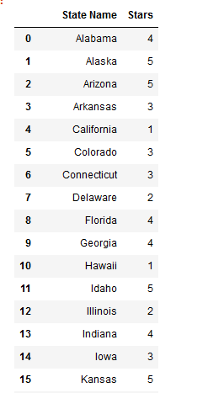
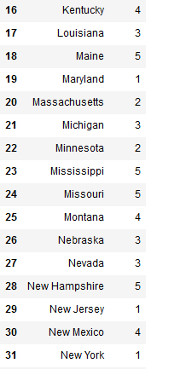
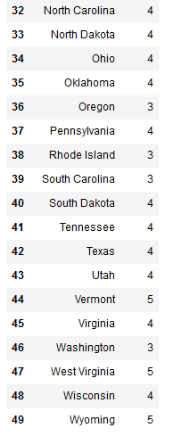
WHAT ELSE DO WE HAVE?
Data on gun friendliness ratings were manually extracted from the source
Census data can be loaded on the fly like this
url = "https://api.census.gov/data/"
api_key = “SECRET"
years = [2013, 2014, 2015, 2016, 2017]
#natstprc=2013-2014 population=2015-2017
datasets = ["natstprc", "natstprc", "population", "population", "population"]
#STNAME=2013-2014 GEONAME=2015-2017
states = ["STNAME", "STNAME", "GEONAME", "GEONAME", "GEONAME"]
#2013:6, 2014:7, 2015:8, 2016:9, 2017:10
date_codes = [6, 7, 8, 9, 10]
query_url = "https://api.census.gov/data/{year}/pep/{dataset}?get={state},POP&DATE={date_code}&for=state:*&key="
response = []
for year, dataset, state, date_code in zip(years, datasets, states, date_codes):
year_url = query_url.format(year=year, dataset=dataset, state=state, date_code=date_code)+api_key
print(year_url)
response.append(requests.get(year_url).json())
https://api.census.gov/data/2013/pep/natstprc?get=STNAME,POP&DATE=6&for=state:*&key=SECRET
https://api.census.gov/data/2014/pep/natstprc?get=STNAME,POP&DATE=7&for=state:*&key=SECRET
https://api.census.gov/data/2015/pep/population?get=GEONAME,POP&DATE=8&for=state:*&key=SECRET
https://api.census.gov/data/2016/pep/population?get=GEONAME,POP&DATE=9&for=state:*&key=SECRET
https://api.census.gov/data/2017/pep/population?get=GEONAME,POP&DATE=10&for=state:*&key=SECRET
Notes:
Question appears -> [Narrator] So, here are the other data sources we used [Click] -> Census data appears -> [Narrator] Census data is available on demand and doesn’t necessary need to be stored in the repository [Click] -> Star ratings appear -> [Narrator] That source didn’t have the ability to download the data so we had to scrape them by hands

Slide 6
ENTER THE ANALYSYS
Notes:
[Narrator] Let the auditory know that now comes the most interesting part

Slide 7
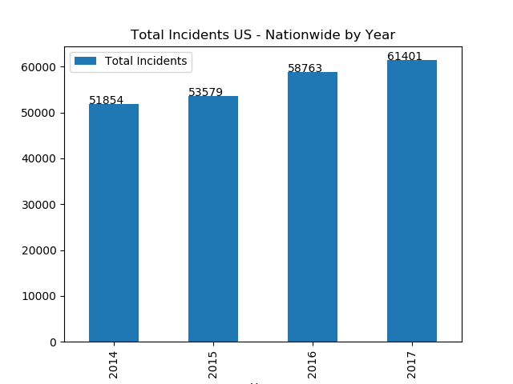
Q: WHAT FUTURE AWAITS US?
A: LIKELY NOT SAFE ENOUGH
Notes:
Question appears -> [Narrator] A couple of words on what we look for comparing time and incident number -> [Click] -> Answer appears -> Charts appear -> [Narrator] Draw a conslusion on the number of incidents growing

Slide 8
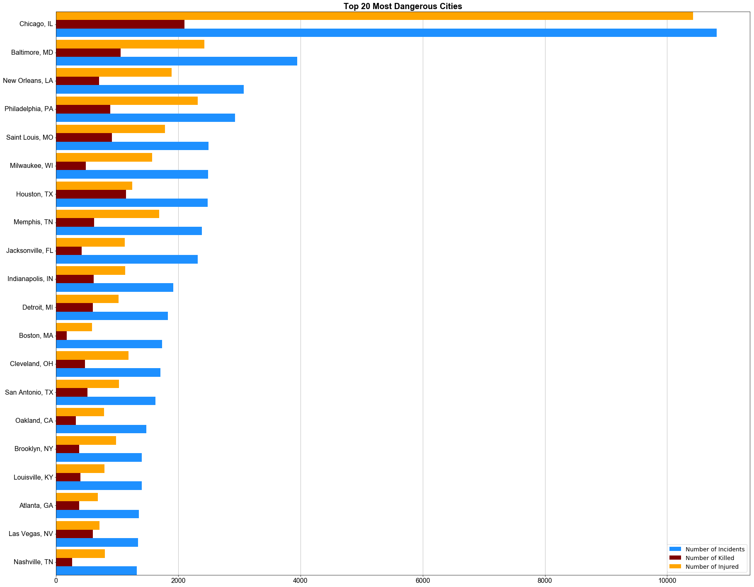
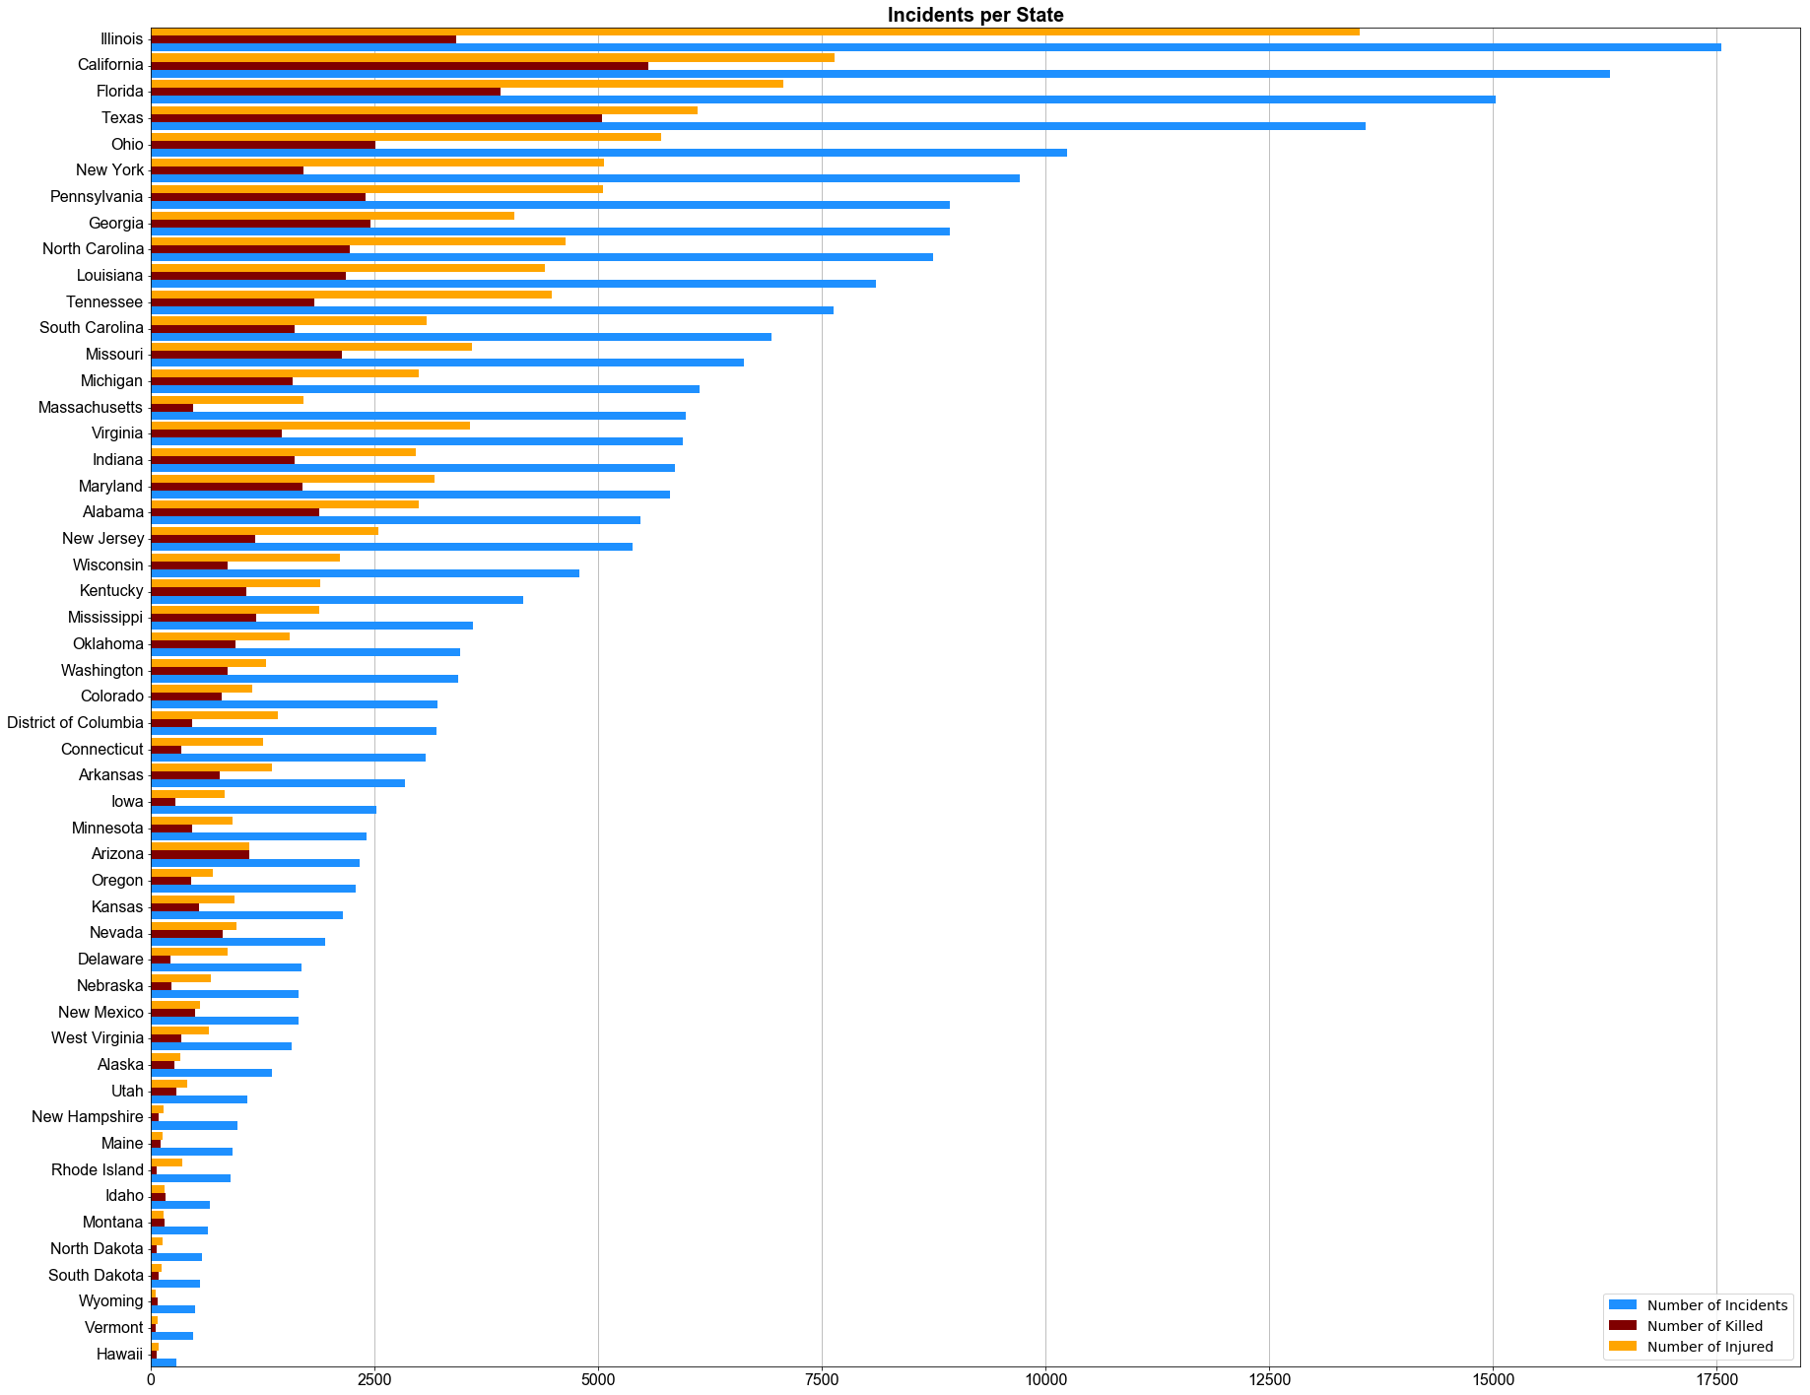
Q: WILL I BE FINE IF I MOVE TO CHICAGO?
A: WEEEELL…
Notes:
Question appears [Narrator] A couple of words about upcoming data – more incidents means more danger [Click] -> Answer appears -> State stats appears -> [Narrator] Discuss the statistics drawing attention to the top states [Click] -> City data appears -> [Narrator] Discuss the statistics, mention Chicago and its mafia history

Slide 9
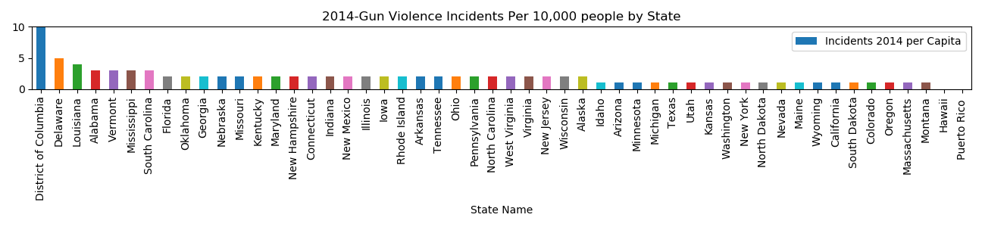
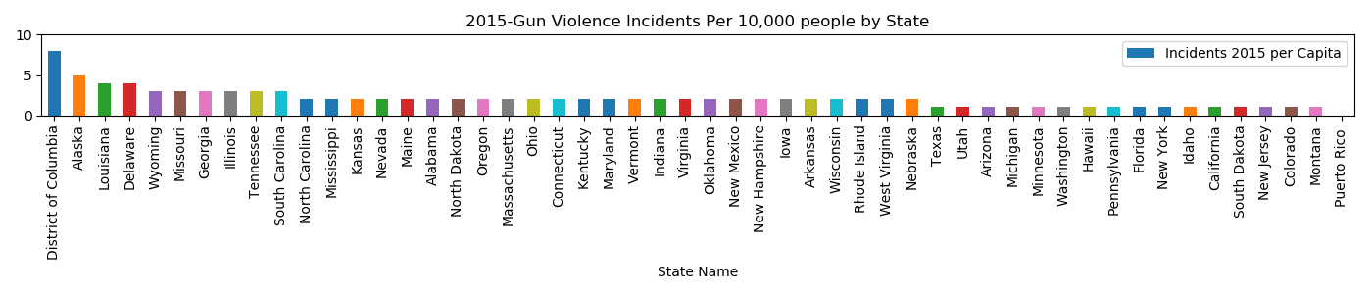
A: BETTER MOVE SOMEWHERE ELSE
Notes:
Top States from 14 to 17: DC, Alaska, Delaware, Louisiana,
Bottom States 14 to 17: California Colorado Hawaii Idaho Oregon Texas New York New Jersey Minnesota Utah

Slide 10
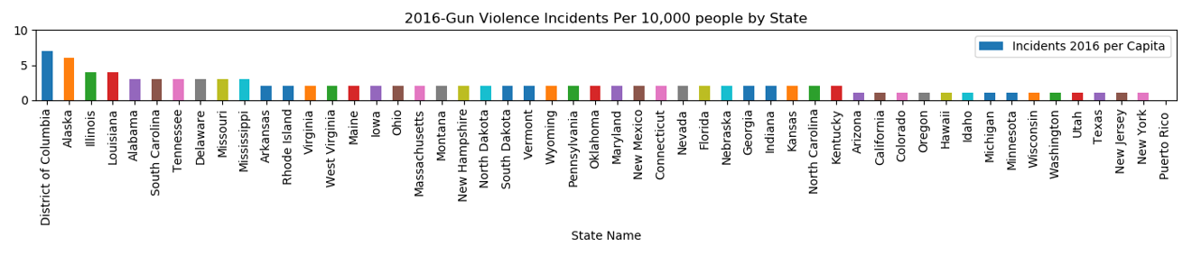
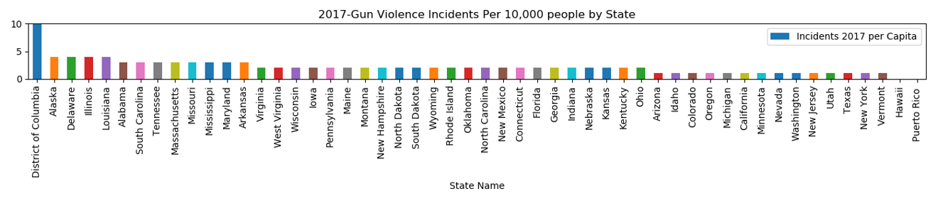
A: OR JUST STAY IN CALIFORNIA
Notes:
Top 5 States : DC, Alaska,
Bottom 5 States:
2016: NY, NJ, Texas, Utah, Washington
2017: Hawaii, Vermont, NY, Texas, Utah

Slide 11
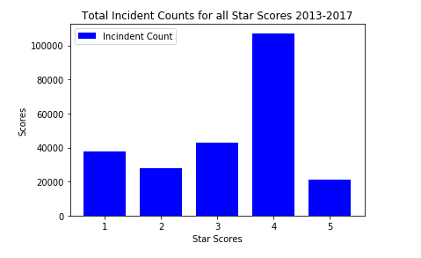
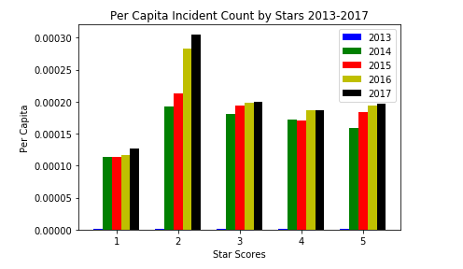
Q: MORE GUNS = MORE SHOOTING?
A: SUPRISINGLY, NOT EXACTLY
Notes:
Question appears -> [Narrator] Discuss what we tried to investigate and what are the components of ‘gun-friendliness’ rating -> Click -> Answer appears -> Charts appear -> [Narrator] Draw a conclusion that there is no correlation

Slide 12
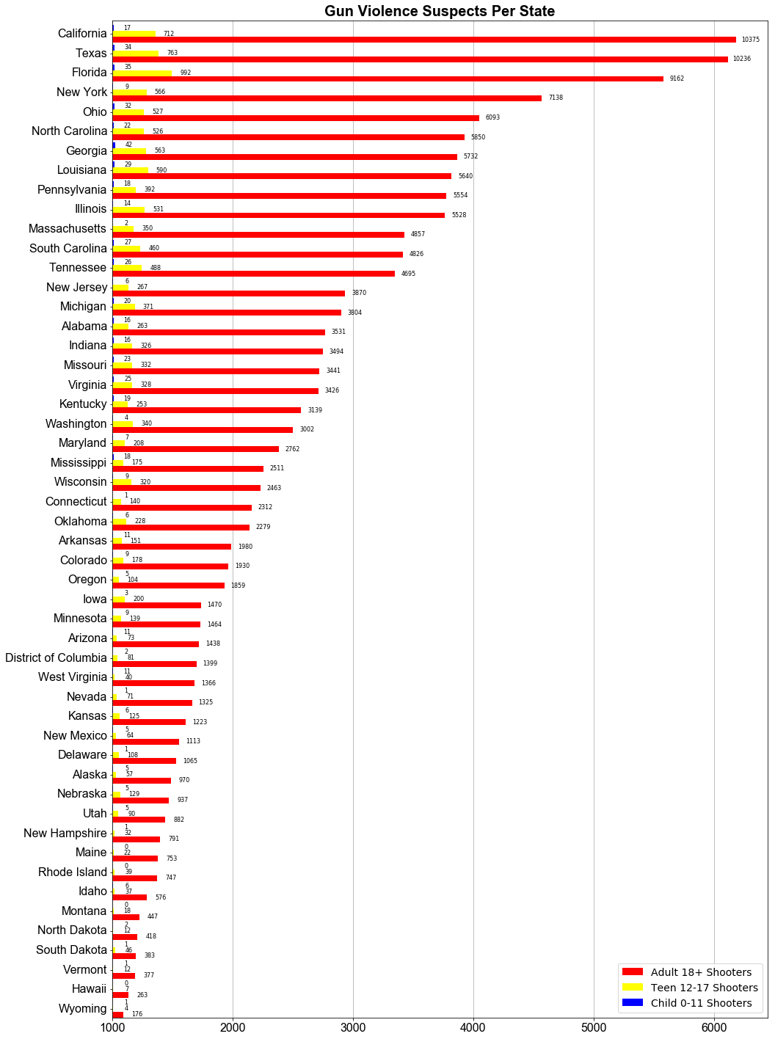
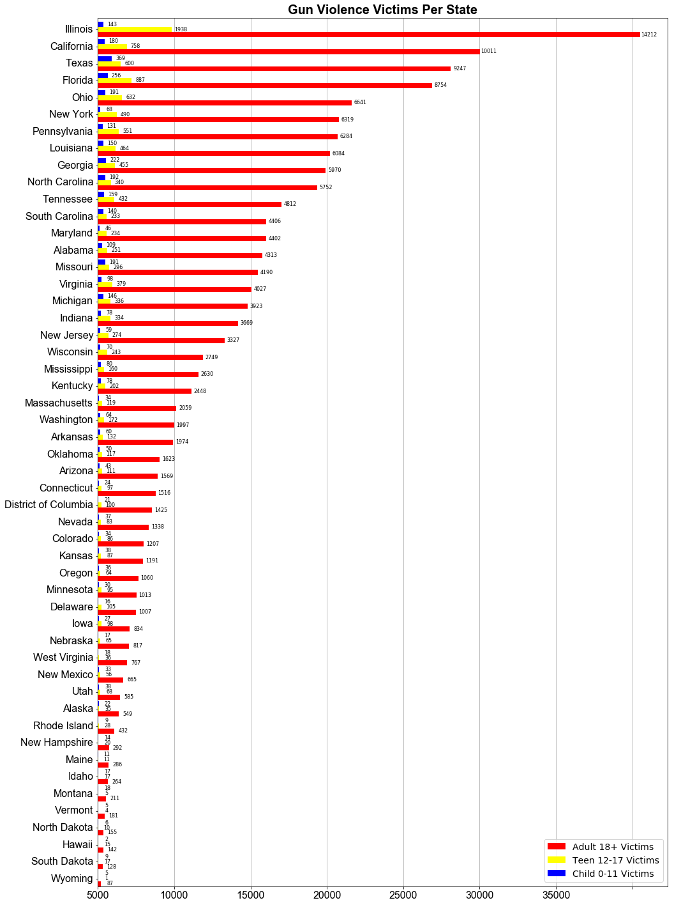

Q: WHO USES GUNS? WHO SUFFERS FROM THEM?
A: OF COURESE ADULTS. BUT TOO MANY TEEN SHOOTERS AND CHILD VICTIMS
Notes:
Question appears -> [Narrator] Explain your goal for uncovering demography-related trends -> Click -> Answer appears -> Charts appear -> [Narrator] Draw a conclusion on the high amount of incident that involve teens and kids

Slide 13
Q: WHAT DO THEY USE GUNS FOR?
A: MOSTLY FOR CRIMINAL PURPOSES
ATF/LE Confiscation/Raid/Arrest
Accidental Shooting
Animal shot/killed
Armed robbery with injury/death and/or evidence of DGU found
Child Involved Incident
Officer Involved Shooting - Officer killed
Car-jacking
Suicide
Gun(s) stolen from owner
Hate crime
Officer Involved Shooting - Bystander killed
Under the influence of alcohol or drugs (only applies to the subject/suspect/perpetrator )
Political Violence
Police Targeted
Spree Shooting (multiple victims, multiple locations)
Assault weapon (AR-15, AK-47, and ALL variants defined by law enforcement)
Pistol-whipping
Concealed Carry License - Perpetrator
Kidnapping/abductions/hostage
Brandishing/flourishing/open carry/lost/found
Possession (gun(s) found during commission of other crimes)
Road rage
Guns stolen from law enforcement
Officer Involved Shooting - subject/suspect/perpetrator suicide by cop
Sex crime involving firearm
Home Invasion
Terrorism Involvement
Home Invasion - Resident killed
Child killed by child
Mistaken ID (thought it was an intruder/threat, was friend/family
Unlawful purchase/sale
Gun at school, no death/injury - elementary/secondary school
Criminal act with stolen gun
Defensive Use
Drive-by (car to street, car to car)
Mass Murder (4+ deceased victims excluding the subject/suspect/perpetrator , one location)
Mass Shooting (4+ victims injured or killed excluding the subject/suspect/perpetrator, one location)
Drug involvement
Home Invasion - subject/suspect/perpetrator killed
Murder/Suicide
Gang involvement
Gun shop robbery or burglary
Hunting accident
Implied Weapon
Domestic Violence
Officer Involved Incident
Notes:
[Narrator] A couple of words about upcoming data – incidents are categorized, one incident can belong to multiple categories [Click] -> Answer appears -> [Narrator] A couple of words about the generic and specific categories

Slide 14
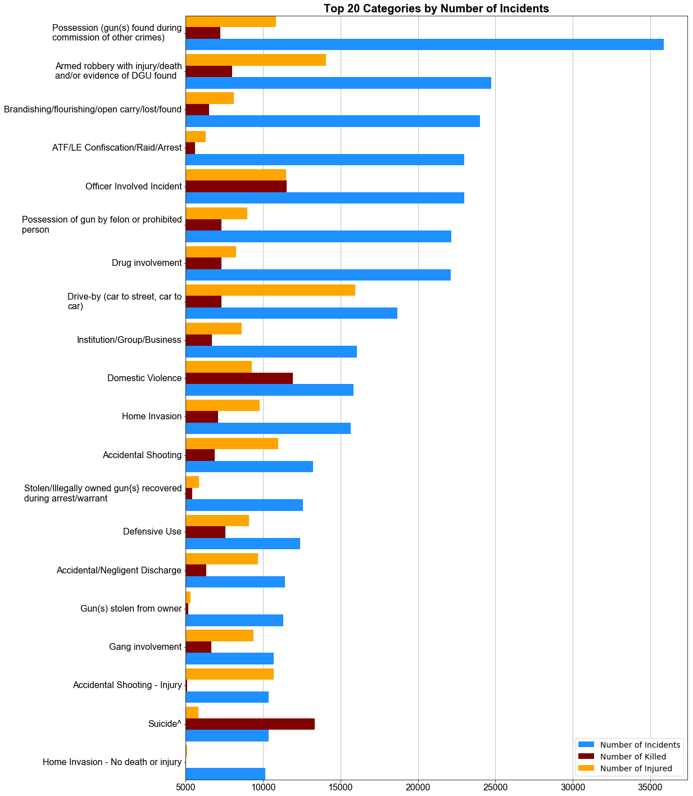
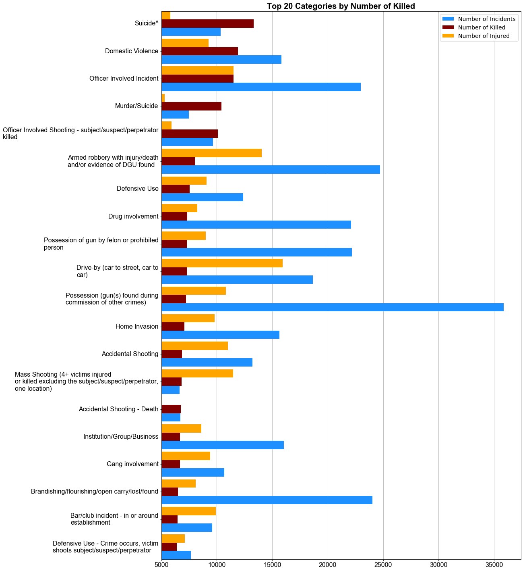
TOO MANY WORDS?
TAKE THIS!
Notes:
[Narrator] Agree that words are not enough [Click] -> Answer appears -> [Narrator] Discuss the top categories from the left (mostly criminals), discuss the top categories from the right, notice some categories that skyrocket from the bottom (suicide, murder/suicide), note defensive use at the bottom

Slide 15
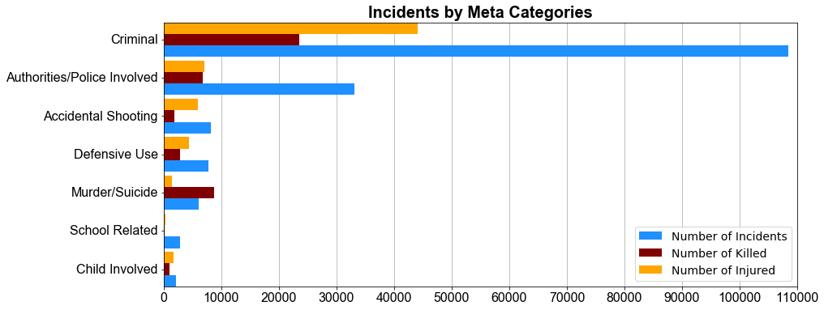
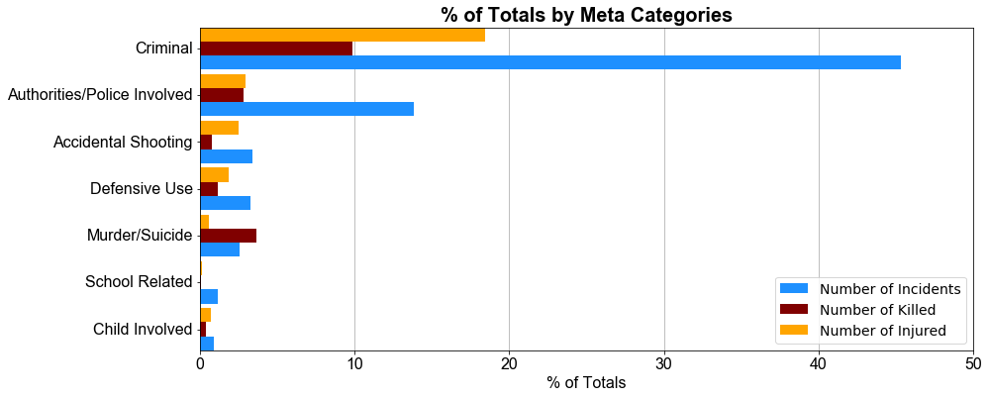
STILL NOT CLEAR?
WHAT ABOUT META CATEGORIES?
Authorities/Police Involved
Child Involved
Defensive Use
Accidental Shooting
Murder/Suicide
Criminal
School Related
Notes:
[Narrator] Approach the idea of meta categories (combine categories into those on the higher level [Click] -> Answer appears -> [Narrator] A couple of words that a single incident most likely belong to the several meta categories. [Click] -> Chart appears -> [Click] -> Percent Chart appears -> [Narrator] Make two opposite conclusions: If guns are outlawed, only outlaws will have guns / defensive use

Slide 16
BUT WHAT IF WE HAD MORE TIME?
Category Influence over Time
Components of Gun-friendliness
Category + Gun-friendliness
Social-related
Notes:
Question appears -> [Narrator] Start telling about what out analysis lacks -> [Click] Future analysis directions appear -> [Narrator] Explain the categories (do we get more e.g. suicides over time, is there a correlation between CCW and kill count, does the weapon permit effectively reduce the number of home invasion incidents, how much does poverty influence the incidents number)

Slide 17
Q & A
Notes:
Wait for bullets to show up

